Slide 1
Team A
Jamie Maynard, Lynn Dongni, Nick Ulrich, Seneca Zuniga, Lynnae Van Voorthuysen

Slide 2
Situation
Convenience stores are not making as much money
57% of shoppers do not even enter the store

Slide 3
Goal
Increase convenience store retailer’s profit by 2% annually
Help independent convenience stores throughout the country

Slide 4
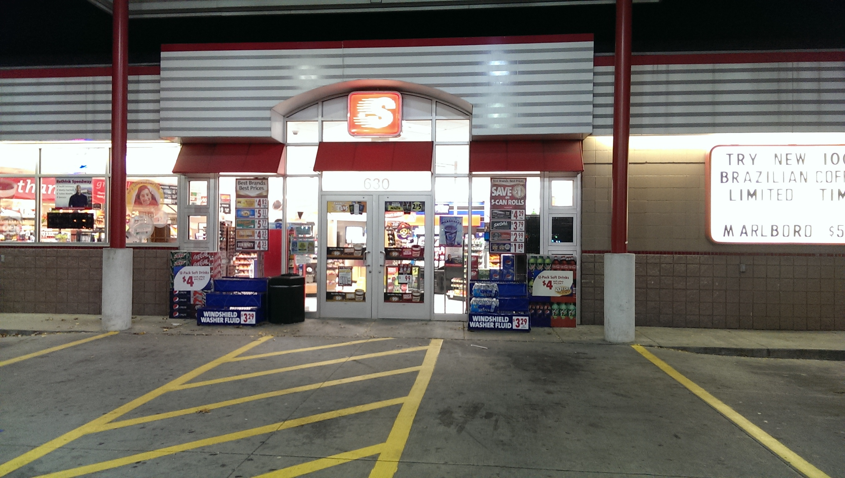
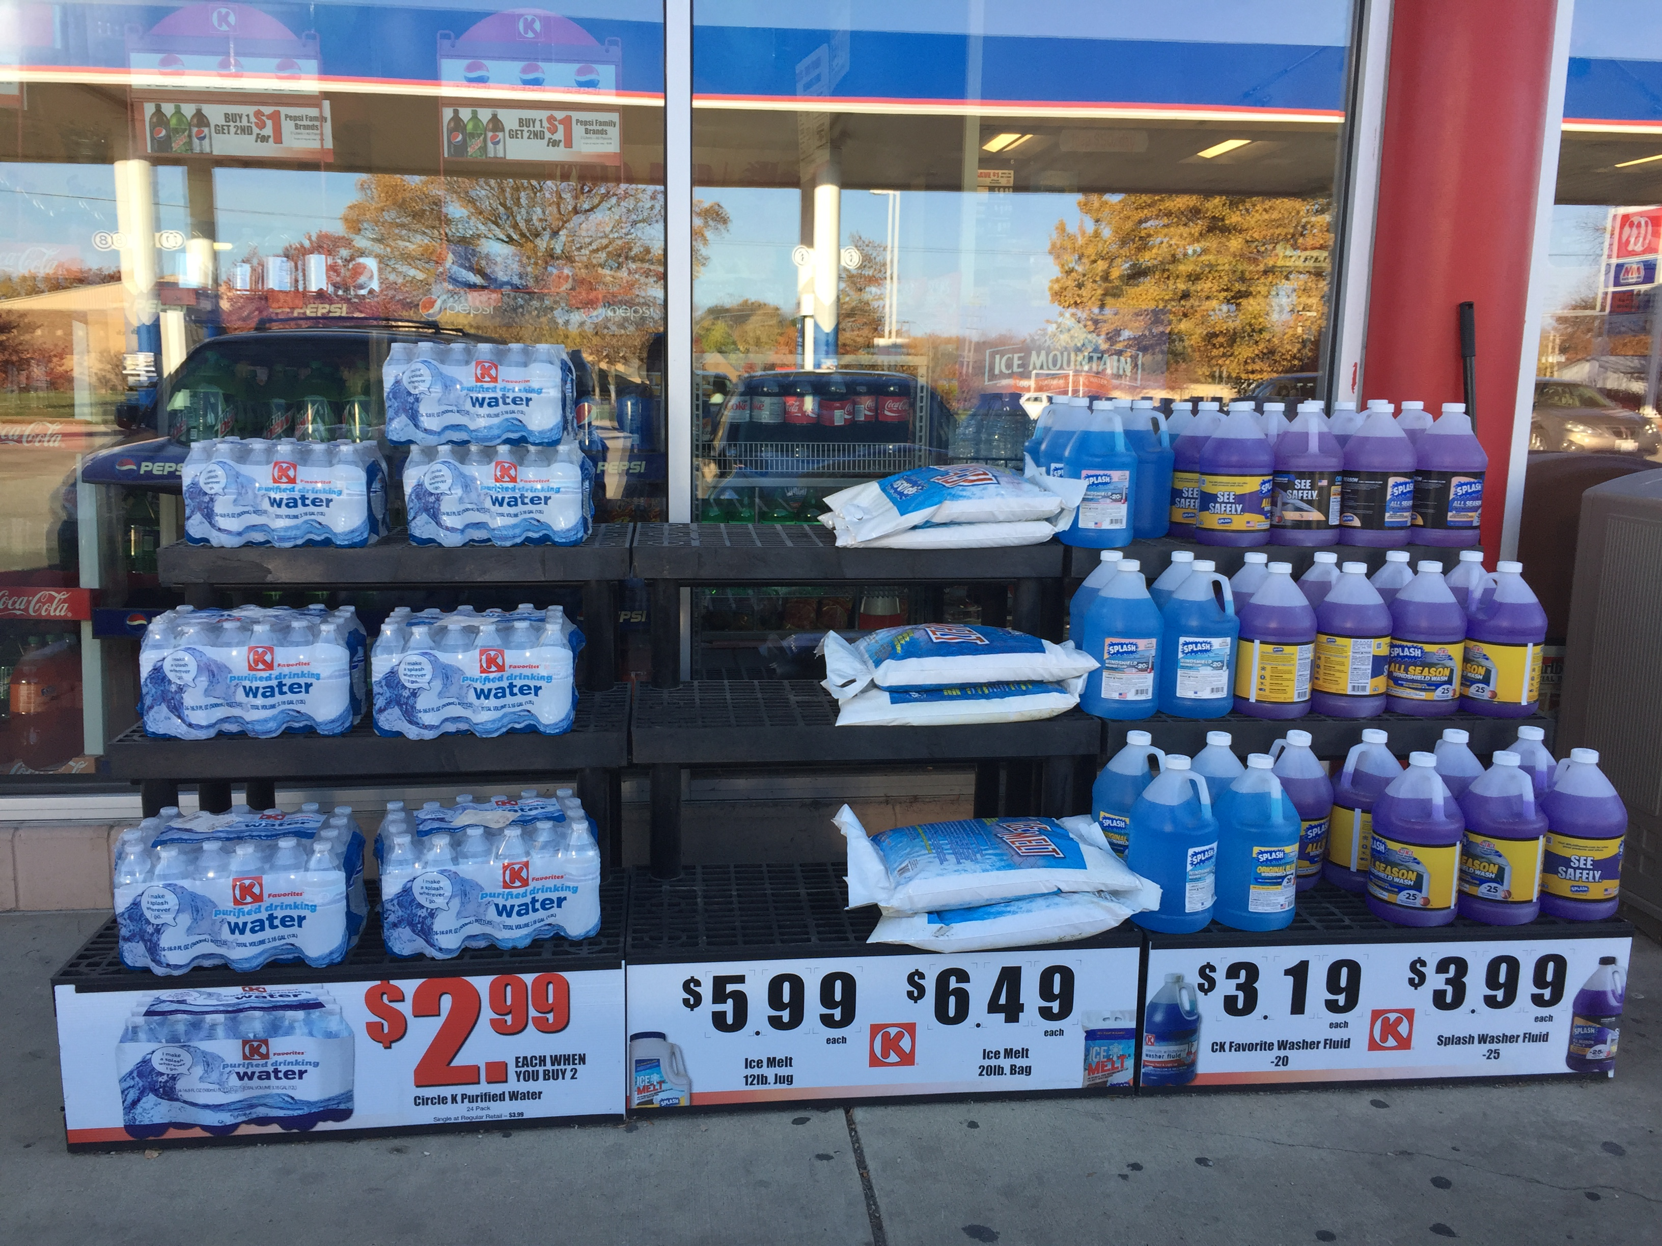
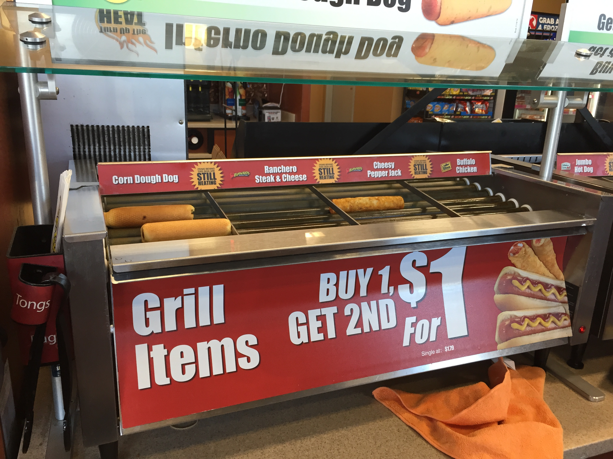
Our Research
Conducted interviews and asked:
What products are purchased most?
What products don’t sell?
What is preventing “gas only” shoppers from entering the store?
Do shoppers usually notice and take advantage of promotions?
Observed shopping behavior
Conducted market research
Convenience Store News
Mobile Commerce Daily
NACS (National Association for Convenience & Fuel Retailing)

Slide 5
Key Findings
Consumers have many reasons to go into the store or not go into the store
Pay for gas in store
Cigarettes
Food & Drinks
Gas purchasing has become a competitive sport
Rise in gas prices
Thrill of finding a bargain
Apps
Time
Overpriced merchandise
Only need gas

Slide 6
Let’s not make them indulge rather lets pay them for their indulgences

Slide 7
Problem #1:
Shoppers may or may not be interested in entering the store.

Slide 8
Solution #1:
Flip the rewards program.

Slide 9
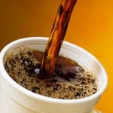
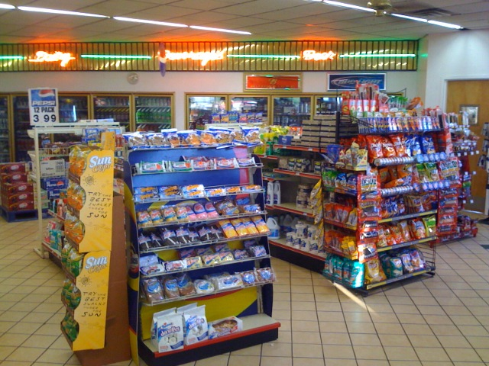
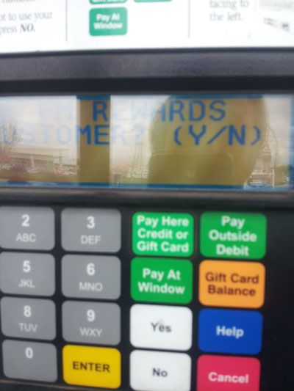
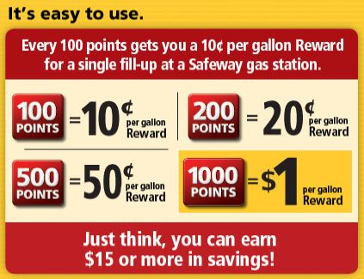
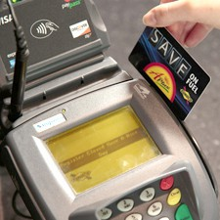
The Shopper’s Journey
Notes:
1. Shopper enters store for routine or indulgent purchase
Scan rewards card or mobile device upon purchase
Points begin to total in consumers rewards account
Each point milestone one reaches higher discount on gas
At the pump or cash register, consumer may use points for discount on fill up

Slide 10
Why it would work
It delivers real value
It’s simple and convenient
Loyalty programs are popular
Notes:
Delivers real value: allows customers to save money on something they need when buying things they want (crave/indulge) rather than them paying full price on something they hate paying to specials on things they may not even buy if they didn’t have the discount or freebie.
It’s simple and convenient: just scan your rewards card and rack up fuel points. Able to use the rewards card at the pump and at the cashier (card or cash) or go completely mobile
The number of rewards programs jumped 27 percent from 2010 through 2012, according to research firm Colloquy. Membership has soared as well. The average U.S. household has 22 loyalty-program memberships and actively uses 10.

Slide 11
In Summary
Situation
Goal
Increase retailer profits by 2% annually
Problem #1
Shoppers may or may not be motivated to enter the store
C-store owners aren’t making as much money as they used to, and 57% of shoppers do not enter the store
Solution #1
Flip the rewards program so that c-store purchases earn free gas
Notes:
Solution #1: Get shoppers to enter the store by flipping the rewards program so that c-store purchases earn free gas

Slide 12
Gas Purchasing: A Competitive Sport
Notes:
Our second key finding:

Slide 13
Meet Mark:
Works in Chicago
Girlfriend is a PhD candidate at UIUC
Spends weekends in Champaign
Drives an Acura TL – an expert in saving gas
Uses GasBuddy to find lowest prices in rural cities before returning to Chicago
Rarely goes into the store
Frequently updates GasBuddy but has yet to win a $100 gift card
Notes:
Male 26
I graduated from University of Illinois Urbana-Champaign (UIUC) last year. Now I am working at a small agriculture equipment company at Chicago. My girlfriend is PHD candidate in physics at UIUC. So now we are having a “long distance” relationship. Normally I will drive to Champaign on Friday’s night and be back to Chicago on Sunday’s night, so I can spend a sweet weekend with my girlfriend. We are planning to get married next year and I am trying to save some money.
My car is Acura TL, which is an “expert” in saving gas. As we all know, Chicago always has a higher gas price than any other little cities like Rantoul, Kankakee or Champaign-Urbana in IL. So I always use an app called “gas buddy” to search lowest gas price before adding gas. Personally, I like this ad. It has accurate gas prices most of the time. It saves me a lot of money because I have to go back and forth at least four times between Champaign and Chicago within one month. The app is clean and easy to use. I do not go into the store because I am in a hurry to go back to home most of the times. Besides, I know the snacks at convenience store will be more expensive than Costco, which I usually shop with. I will keep using this app to save my money spending on gas.

Slide 14
Problem #2:
There is no unified reason to go into the store.

Slide 15
A most convenient solution to an inconvenient problem:
Use technology to create a
unified reason to go into the store

Slide 16
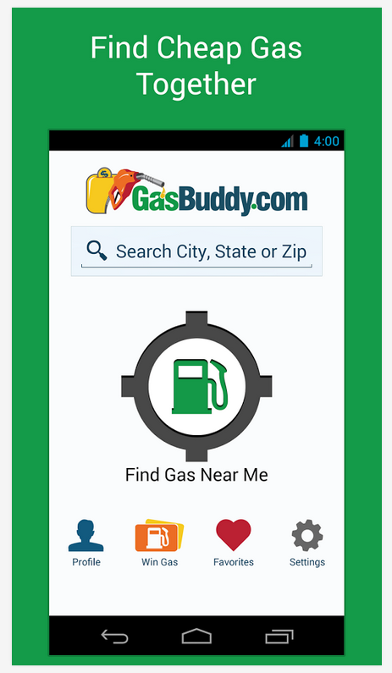
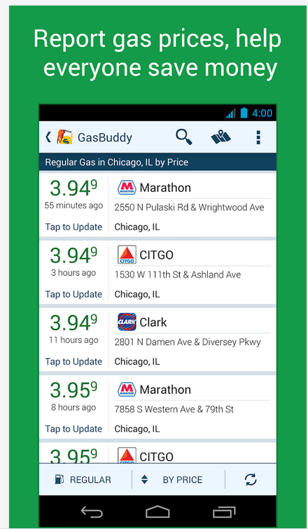
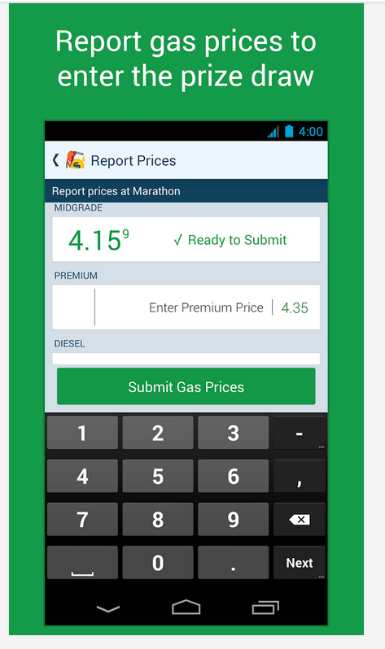
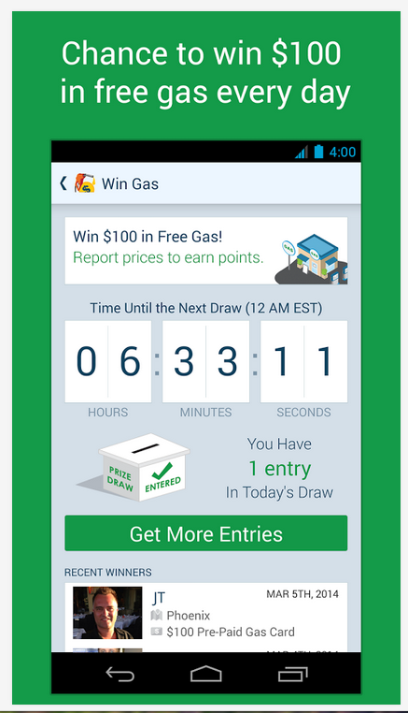
35 million downloads
5 star mobile app
Top free app in travel category

Slide 17
Shopper’s Journey
Update gas prices to help others save money too!
1
2
Thanks for the update!
3
4
Notes:
Shopper uses GasBuddy to locate station with cheapest gas
Upon arrival GasBuddy prompts the user to update the gas price
When the user updates the price, the app generates an immediately redeemable reward coupon for a free or discounted in-store item
The user then goes into the store to redeem his/her coupon
Inside the store, the user may purchase additional items

Slide 18
Rewards Ideas

Slide 19
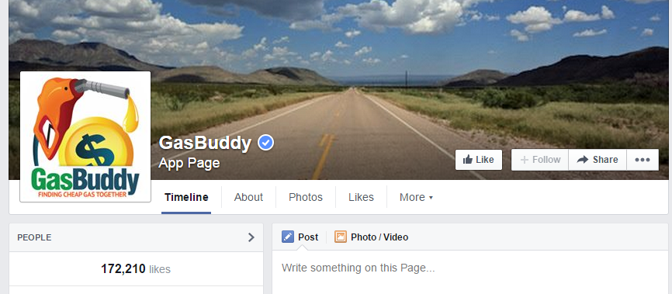
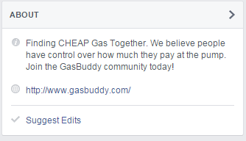
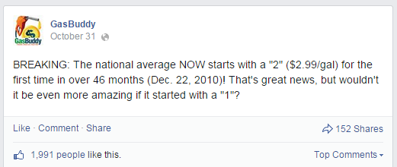
Continuous Communication

Slide 20
An update from Mark:
After Our Communication
There are instant perks for updating GasBuddy now!
Today I ran in for my free Turkey Jerky and grabbed a coke and some chips too.
I was surprised to see how reasonably priced beer is with the current promotion.
I like being part of the conversation on GasBuddy’s Facebook page.
Notes:
Today, I noticed that Gas Buddy begins to remind me there are plenty of promotions running at convenience stores. I can get free candy during Halloween. That is sweet! I even did not notice this kind of activities before! I went into the store and grabbed few candies. The thing surprised me is that the beer is not as expensive as I imagine. Actually, there is a promotion running at store. I would definitely love to buy some and share with my girlfriend this weekend!

Slide 21
Benefits
Convenience Store Owner
Shoppers are going inside
Additional purchases once inside the store
Increased profits
Opportunity to build brand loyalty
Retailer opportunities to advertise on GasBuddy
GasBuddy
Better data from more updates
Build app loyalty
Appear as promotion sponsor
Provide instant gratification
Minimize dissatisfaction with unlikely win of $100 gift card
MillerCoors
Build strong relationship with convenience store owners
Help their retailers stay in business
Become a preferred partner

Slide 22
In Summary
Situation
Goal
Increase retailer profits by 2% annually
Problem #2
There is no unified reason to go into the store
C-store owners aren’t making as much money as they used to, and 57% of shoppers do not enter the store
Solution #2
Partner with GasBuddy to create a unified reason to go into the store
Notes:
Solution #2: Get GasBuddy users to enter the store by promoting free gifts and promotions in store

Slide 23
Appendix

Slide 24
The interview questions: 1. What are the top 5 merchandise sold in the store? Cigarettes, Beer, Soft drinks, Candy, Snacks 2. What are they not buying? Basically they are buying everything. However, items like dogs' food are the seldom bought things. 3. What is preventing "gas only" shopper from entering the store? They are in a hurry/on their ways to work or home, which means just passing by and does not have a need except gas. 4. Do they usually notice the promotion? Yes, definitely. 5. Do they engage the promotion when they notice? Yes, they will once they notice. And the interesting thing is that people still come to store buying the same thing even the promotion is not available any more. 6. What changes will you make for store if possible? No. The people we interviewed are satisfied with their stores' condition.

Slide 25
Live & Monthly Rewards
Condition | Coupon for free:
Lottery goes about $100 million | 100 Grand bar
Weather goes below 12* | 12 fl. oz. hot chocolate
Life gave you lemons today? | 22 fl. oz. Minute Maid Lemonade
Month | Reward Idea
Jan. | Weight loss resolution: Water bottle
Feb. | Valentines Day: Candy
Mar. | March Madness: Chips for the game
April | Easter Eggs
May | Mother’s Day: Starbucks Frappuccino
June | Prepare for Summer BBQ: Propane refill
July | Red, white & blue: Popsicle
Aug. | Road trip: Favorite snack under $3
Sept. | Football season: Bag of ice
Oct. | Tricks & treats: Halloween candy
Nov. | Thanksgiving: Turkey Jerky
Dec. | Winter: Windshield washer fluid

Slide 26
Sources

