Slide 1
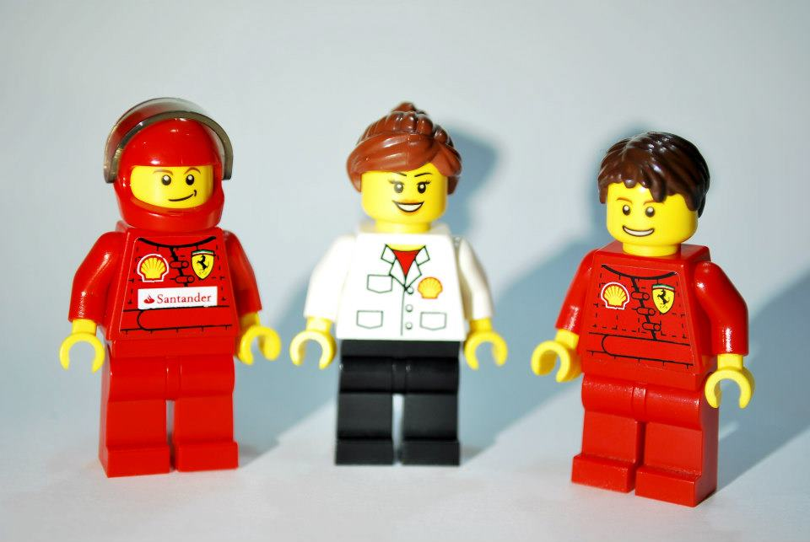
Guilty by Association?
An Analysis of LEGO’s Corporate Partnership with Shell

Slide 2
History & Corporate Philosophy
“Inspire and develop the builders of tomorrow”
1961
A worldwide expansion
2004
First non-family CEO appointed
1932
Lego story begins
2000
‘Toy of the Century’
1958
The launch of plastic Lego bricks
1974
First Minifigures introduced
2003
Financial Crisis of LEGO
2014 LEGO becomes the largest Toymaker

Slide 3
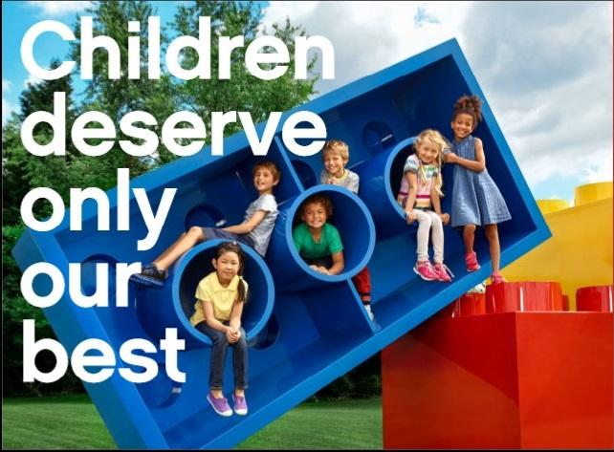
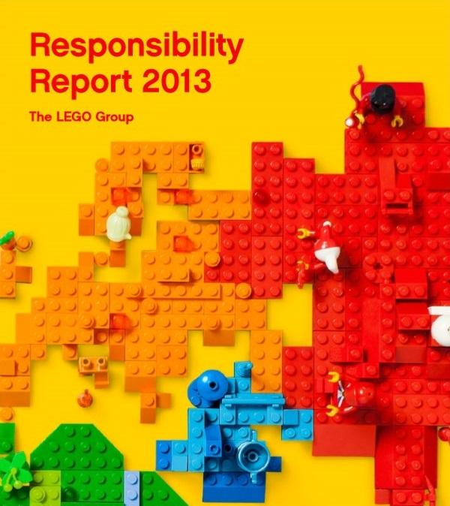
LEGO & Responsibility
Pioneer Safety
Care for nature
Support children’s right to grow
Encourage respectful stakeholder dialogue

Slide 4
LEGO’s Previous Challenges
✦ 2011: Greenpeace targeted LEGO’s supplier Asian Pulp & Paper (APP) for deforestation in Indonesia.
LEGO, Disney, Mattel were criticized for their affiliation
LEGO cancelled its contract with APP
✦ 2011: LEGO FRIENDS was criticized for reinforcing gender stereotypes in its marketing srategy.
A 7-year girl sent a lettr to LEGO;
Activists started petition on Change.org;
2014: In response, LEGO announced the launch of the ‘Research Institute’ set, which contains minifigures of female scientists.

Slide 5
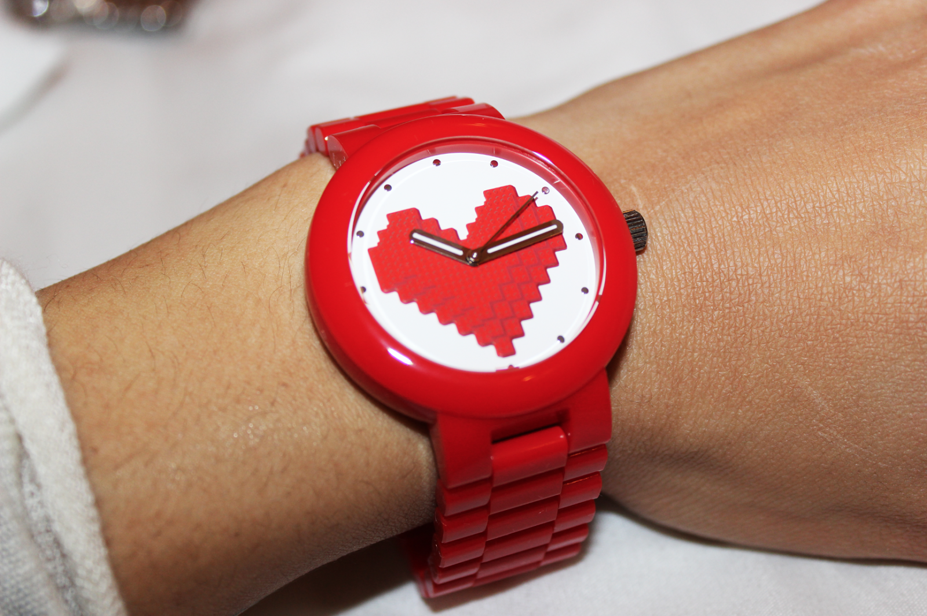
Diversification Failure
✦ The Lego Group lost money four out of the seven years from 1998 through 2004.
✦ Sales dropped 30 percent in 2003 and 10 percent more in 2004.
✦ Lego Group executives estimated that the company was losing $337,000 in value every day.

Slide 6
Successful Turnaround
2004: 7-year Turnaround Plan Begins
✦ Going back to the core of business
✦ Renewing Organizational Values
✦ Staying Relevant
•Customer insights
•Digital Age
•Movie

Slide 7
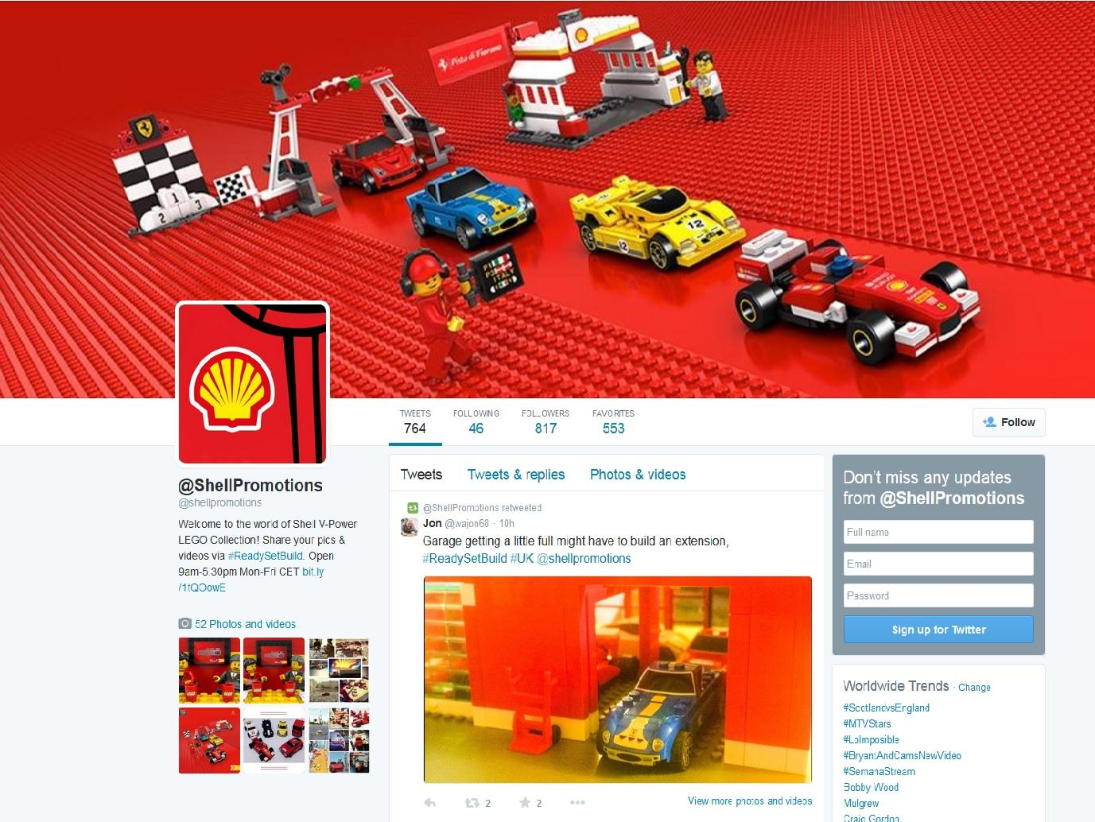
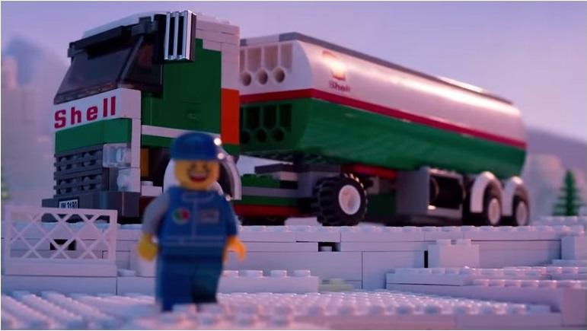
LEGO & Shell
Shell-branded toy sets are currently distributed at petrol stations in 26 countries around the world.
Estimated co-promotion partnership value is around $103-116 million.
LEGO & Shell partnership dates back to the 1960s.
Notes:
Read more: http://www.businessinsider.com/afp-lego-to-drop-shell-partnership-bowing-to-greenpeace-pressure-2014-10#ixzz3JSdQgGji

Slide 8
Shell and the Oil Industry
✦ Royal Dutch Shell is the biggest European oil and gas company (market cap is $223.3B) headquartered in the Netherlands and incorporated in the United Kingdom
✦ Shell had two oil spills in Nigeria in 2008
✦ In summer 2014, Shell revealed its plans to explore for oil in the Arctic in 2015
✦ Energy is one of the least reputable industries, according to the Reputation Institute
Notes:
Royal Dutch Shell plc, commonly known as Shell, is a biggest European oil and gas company headquartered in the Netherlands and incorporated in the United Kingdom.

Slide 9
The Greenpeace Campaign
✦ On July 8, 2014 Greenpeace released a video on YouTube.
✦ The video utilizes LEGO’s marked with the Shell logo in Arctic setting.
✦Soon the video became the most viral video in the history of Greenpeace (more than 6 million views)
Notes:
http://www.theguardian.com/voluntary-sector-network/2014/oct/10/greenpeace-lego-shell-climate-change-arctic-oil
Input video

Slide 10
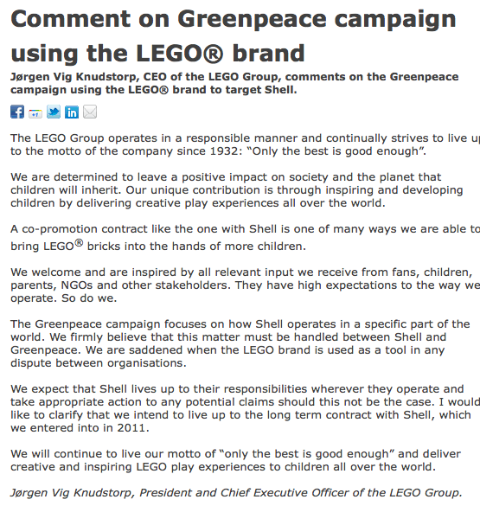
LEGO’s Response
✦ The official LEGO’s statement was released on October 3, 2014.
✦ LEGO says that the campaign was unfairly targeted.
✦ LEGO also says that the company will end partnership with Shell after current contract.

Slide 11
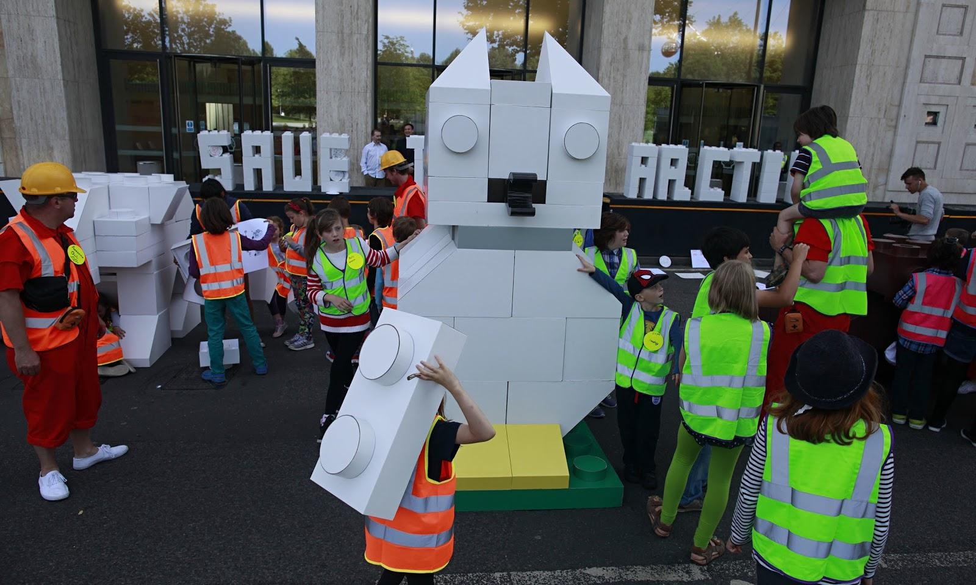
Media’s Reaction
✦Slow to react
✦Jumping aboard with Greenpeace
-Spreading the word
-Detailing the urgency
-Rejoicing at partnerships end
Notes:
With these three features PR professionals picked up the story and ran with it helping to spread the message across the internet and around the world. a journalist to participate and report on a creative ideas session with top designers and creative agencies. This ensured Lego heard it on the grapevine that we were planning our next big push.

Slide 12
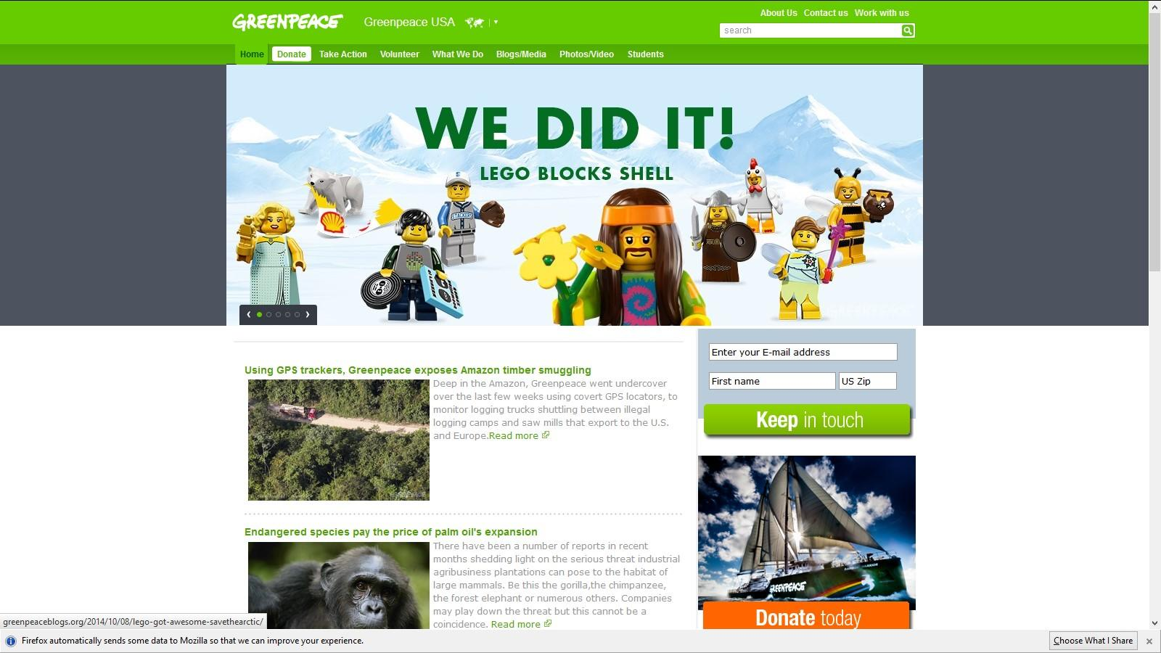
Greenpeace’s and Public Response
✦ Greenpeace celebrates victory. The question is: “Is everything awesome again?”
✦ Michael Skapinker of the Financial Times:
“In our driving, flying and phone-charging, in the buildings we work in and the homes we heat, we are all implicated in the use of fossil fuels“.
Notes:
✦LEGO is a great company. It has fantastic social and environmental values and has made real leaps in reducing its environmental impact.
✦But by helping to mask Shell’s environmental crimes, LEGO are not living up to their own standards, or demonstrating any consideration for the planet our children will inherit.
✦But some argue “In our driving, flying and phone-charging, in the buildings we work in and the homes we heat, we are all implicated in the use of fossil fuels," states Michael Skapinker of the Financial Times.

Slide 13
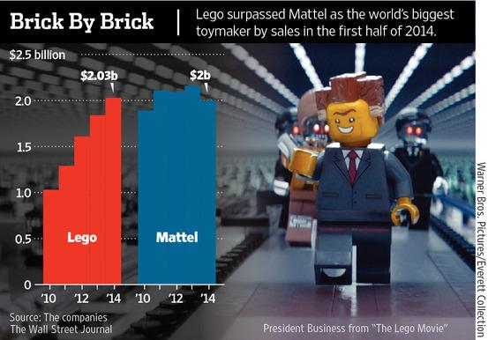
Financial Impact
✦First-half (2014) Lego revenue rose 11%, to DKK 11.5 billion (USA $2.01 billion) from DKK 10.4 billion during the same period last year
✦LEGO has overtaken Mattel as the world’s biggest toymaker by sales
✦Estimated $103 million partnership ending
✦Second half numbers not yet released, continue increase in sales after Greenpeace campaign?
Notes:
No second half numbers released

Slide 14
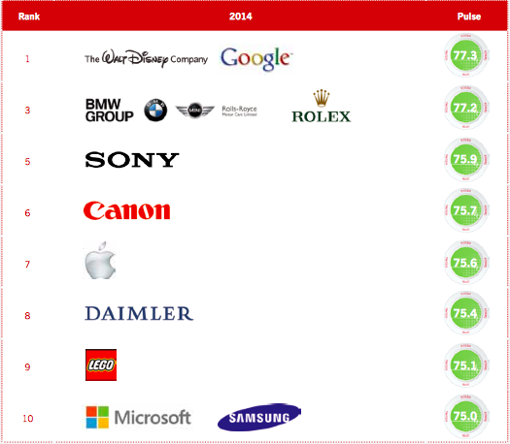
Reputational Impact
✦Global RepTrak ranks the LEGO Group at #9.
✦Have been #1 on Dutch reputation list for past 6 years.
✦Will LEGO’s reputation
show a decline when next ratings are released?
Notes:
Slight hit on “LEGO can do no wrong” image but much expert opinion has not come out yet about the impact this has had on LEGO. Strong reputation throughout Europe. Interesting to see the ranking for next year.

Slide 15
LEGO’s Long-Term Challenges
✦Keep up with the growing demand for transparency.
✦Take proactive approaches to communicating company’s mission and values.
✦Continue pursuing sustainable ways of manufacturing Lego bricks.
✦Build relationships with NGOs, activist groups and other stakeholders.

Slide 16
Application of Arthur W. Page Principles
1. Tell the truth
Truthfulness of the information is vital in communicating transparency. Truthful content builds trust and credibility.
Although LEGO released statements in the beginning and end of the aftermath of the Greenpeace campaign, there were opportunities that arose throughout the campaign where they could have communicated and been more transparent with the public, for example, when petitioners took to the stairs of LEGO’s HQ’s but were quickly removed from the premises without any comment from LEGO. Many journalists didn’t get comments from LEGO. LEGO should have engaged in more communication throughout the process of the Greenpeace campaign to maintain its credibility.

Slide 17
2. Prove it with action
The public evaluates companies on what they say, but what they do.
LEGO proved its oppositional stance on Shell’s plan for the arctic drilling by not renewing its long standing partnership with Shell. However, the reasons that led LEGO to this decision were not stated in the statement, which leaves a question about the authenticity of the decision. Though insufficiently expressed, LEGO has engaged in many CSR initiatives to preserve the environment. However, these activities are not well marketed, thus they seldom lead to creating better perception of the company.

Slide 18
3. Listen to the customer
LEGO has demonstrated that it values their customer’s voices through their actions upon being challenged or criticized by the public. When criticized for its affiliation with APP, LEGO terminated its contract. Upon receiving the criticisms for its gender stereotypical products, LEGO friends, LEGO developed and released ‘Research Institute’ with portrays non-biased representation of girls.
While LEGO’s actions demonstrate that the company listens to its customers, their action seem reactive rather than proactive.

Slide 19
4. Manage for tomorrow
LEGO seems to focus on tomorrow as its mission states; “inspire and develop future builders of tomorrow “. However, the sense of “tomorrow” seems to lack in their Public Relations and business strategies. If LEGO had truly understood the trend in public opinion, they would have predicted the public’s reaction and reevaluated their partnerships with Shell as well as APP at earlier stage instead of waiting for the issues to arise.
As consumers are questioning the safety of the products they purchase and use, it can be predicted that there will be a demand for an open discussion of what LEGO bricks consist of and potential health risk of polymers. Before questioned or attacked by the public, LEGO should proactively start a conversation about this and let the public know of their continued research for safer products.

Slide 20
5. Conduct public relations as if the whole company depends on it
As mentioned in Arthur W. Page Principles, public perception of an organization is determined 90 percent by what it does and 10 percent by what it says. In other words, a company should not avoid interviews and talking to journalists and other stakeholders. With the growing demand of transparency, any company should take proactive approaches to communicating company’s mission and values. Moreover, any company should not only be ready to answer questions, it should be able to be active itself and to engage stakeholders in the dialogue. Managing such open communication is a must for every company operating in the modern world.
Facing Greenpeace’s attack, LEGO should have been more open in terms of communication. LEGO refused to comment many times, and it seemed that the company did not know what to say, while Greenpeace used every opportunity to state its message in mass media.

Slide 21
6. Realize a company’s true character is expressed by its people
It is stated on the company's website that employees are important to LEGO. LEGO claims to be dedicated to ‘ensuring that its employees’ competencies and creativity continue to develop’, because they are fundamental in living up to and delivering on the company’s values. http://aboutus.lego.com/en-us/sustainability/our-approach
Although employees are encouraged to be open and discuss all issues with their immediate supervisor, they didn’t appear at all in the context of the conflict with Greenpeace. CEO was the only representative of LEGO who stated the company’s position on that issue. LEGO should have more spokespeople to comment and talk to mass media representing the company.

Slide 22
7. Remain calm, patient and good-humored
Instead of attacking Greenpeace back (this reaction would be reasonable for a company feeling innocent), LEGO remained calm and patient. The toy company explained in its statements clearly that although LEGO would stop its partnership with Shell, LEGO could do nothing about Shell’s plan to drill in Arctic and that Greenpeace should have targeted Shell directly.

